Slide 1


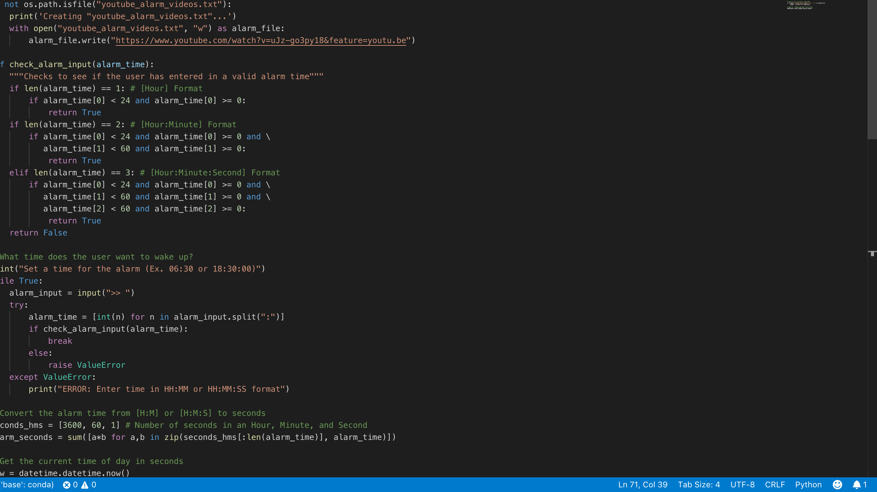

code
Wake Up Dr. Thomas! – your python alarm clock
This code was found on GitHub and modified to our specifications
By Fortune Onwuzuruike & Janae Logan
Notes:
This will open Visual Studio Code on my computer and take us to the code when “specifications” is clicked.

